Slide 1

Credit Card Transaction Report
Comprehensive analysis of credit card transactions, revenue performance, and customer insights across multiple dimensions.

Slide 2
Key Performance Metrics
$57M
$8.0M
667.2K
$45.5M
Total Revenue
Total Interest
Transaction Count
Transaction Amount
Generated across all card categories and transaction types
Interest earned from customer transactions
Total number of transactions processed
Total value of all transactions

Slide 3
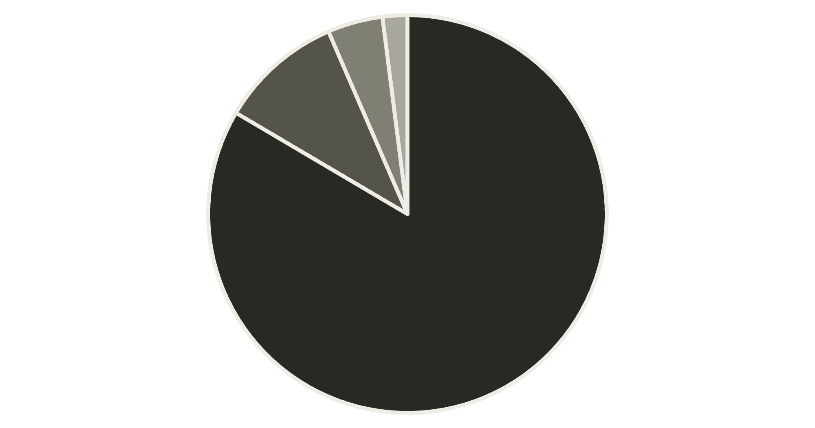
Revenue by Card Category
Category Breakdown
Blue cards dominate revenue at $47M (83%), followed by Silver at $6M. Gold and Platinum cards contribute $3M and $1M respectively.
Total interest earned across all categories: $8.0M
Blue
Silver
Gold
Platinum

Slide 4
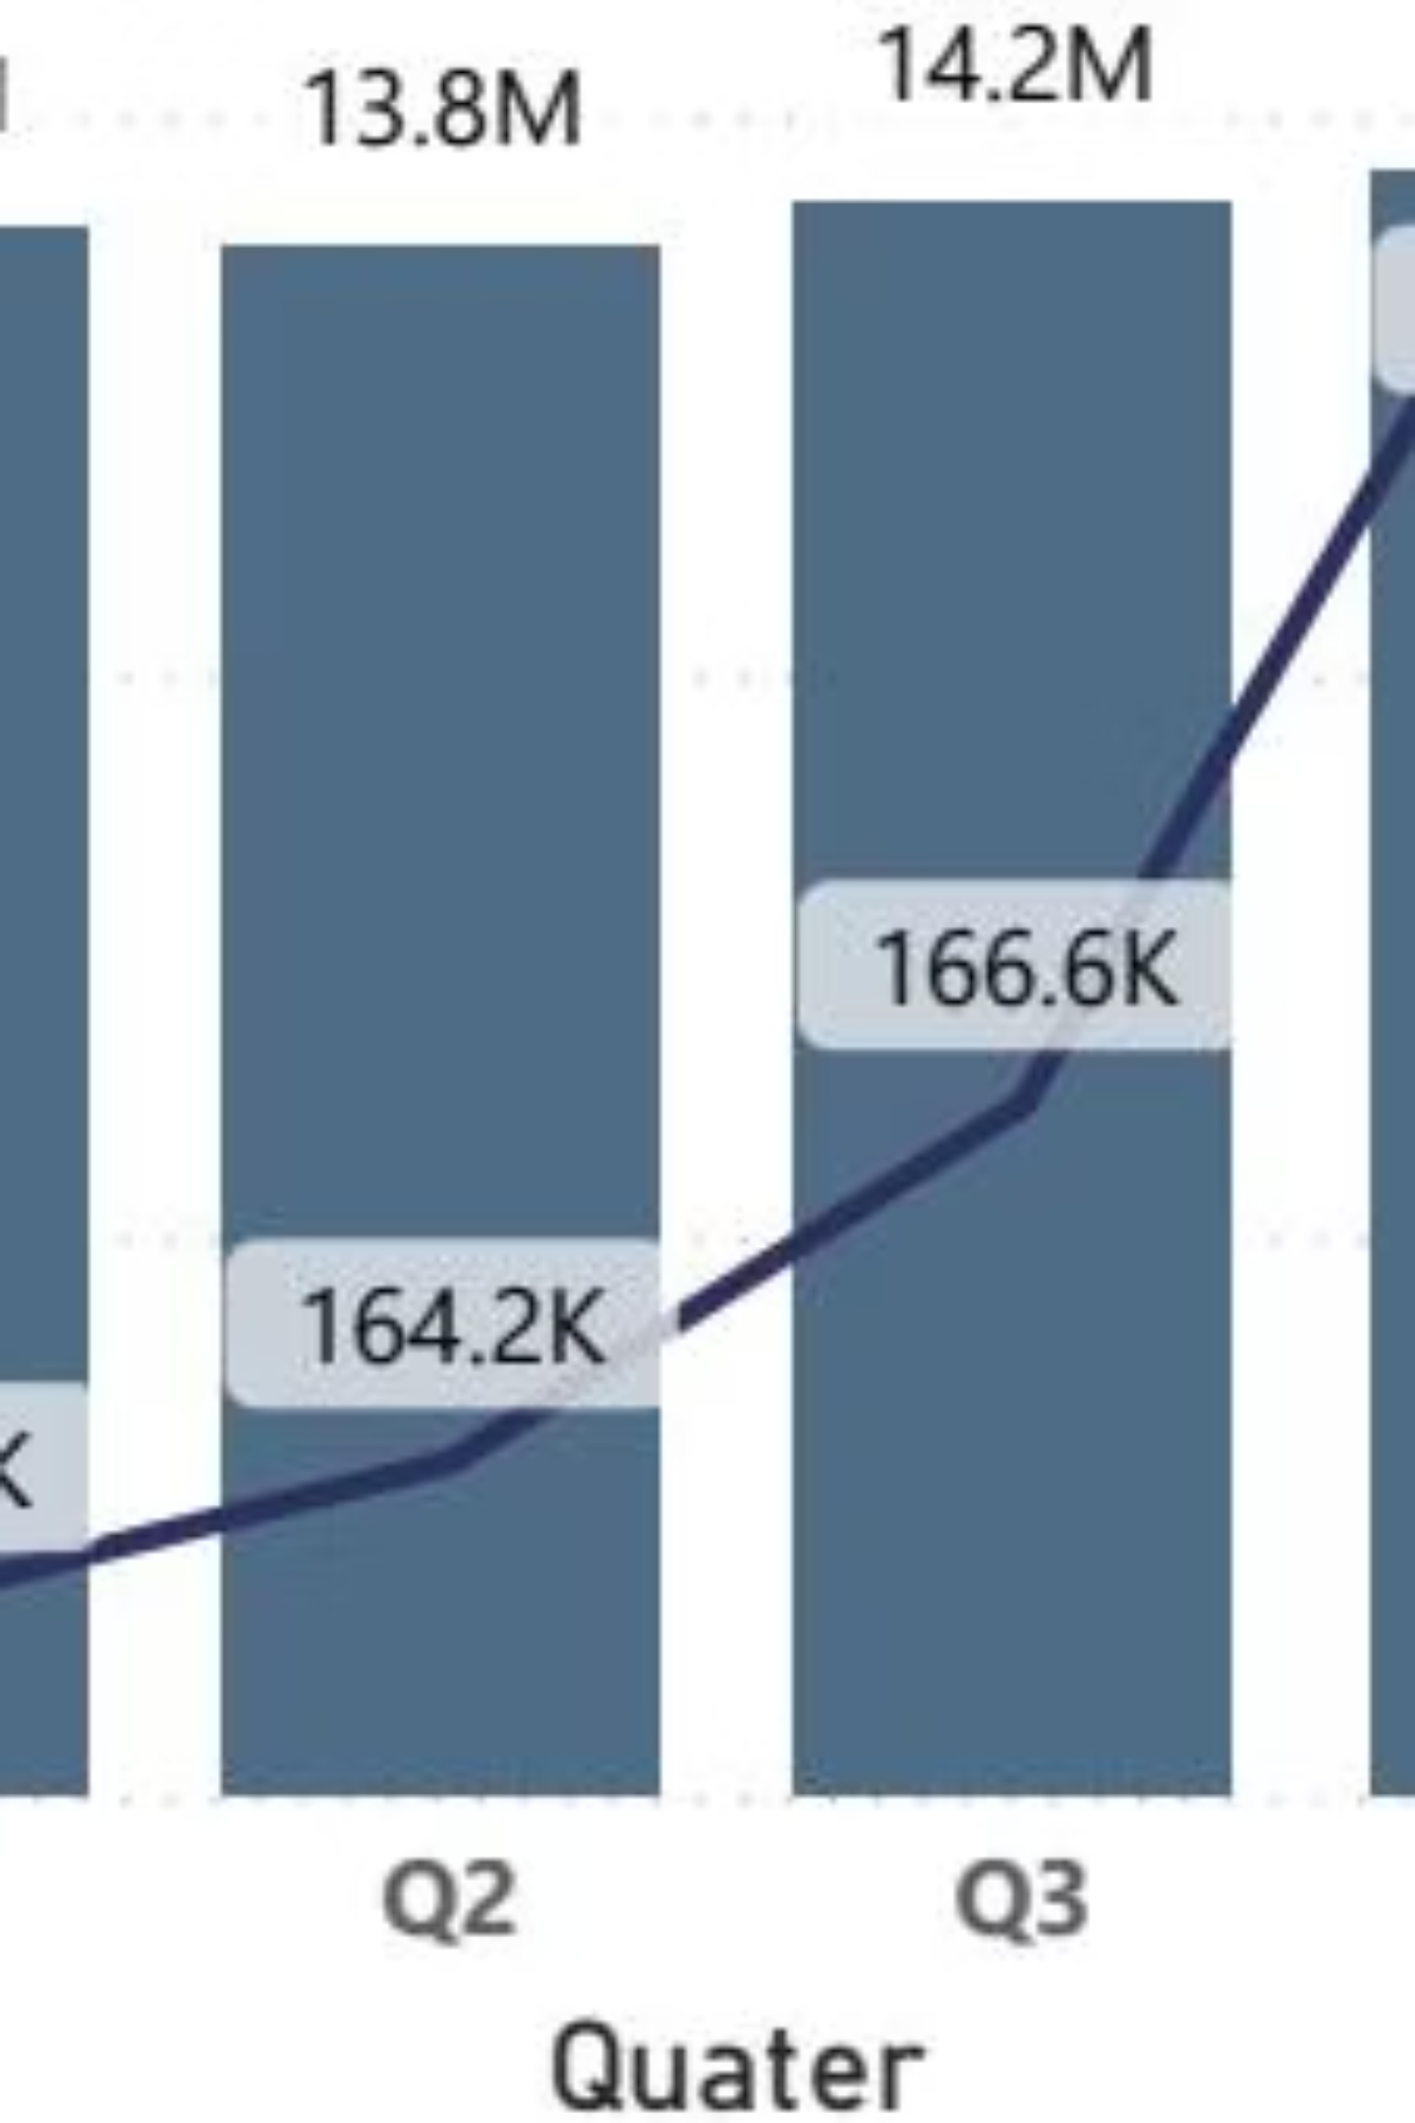
Quarterly Performance Trends
Q1 Performance
Revenue: $14.0M
Transactions: 163.3K
Q2 Performance
Revenue: $13.8M
Transactions: 164.2K
Q3 Performance
Revenue: $14.2M
Transactions: 166.6K
Q4 Performance
Revenue: $14.5M
Transactions: 173.2K
Steady growth in transaction count from Q1 to Q4, with Q4 showing the highest transaction volume at 173.2K.

Slide 5

Revenue Distribution Analysis
By Job Type
By Education Level
Businessman: $18M
Graduate: $23M
White-collar: $10M
High School: $11M
Self-employed: $9M
Unknown: $9M
Government: $8M
Uneducated: $8M
Blue-collar: $7M
Post-Graduate: $3M
Retirees: $5M
Doctorate: $2M

Slide 6
Spending Patterns by Category
1
2
Bills
Entertainment
$14M in revenue
$10M in revenue
3
4
Fuel
Grocery
$10M in revenue
$9M in revenue
5
6
Food
Travel
$8M in revenue
$6M in revenue
Bills lead expenditure at $14M, followed by Entertainment and Fuel at $10M each.

Slide 7



Card Usage Methods
64%
30%
7%
Swipe
Chip
Online
$36M in revenue
$17M in revenue
$4M in revenue
Traditional swipe transactions dominate at 64%, while chip and online payments account for 30% and 7% respectively.

Slide 8

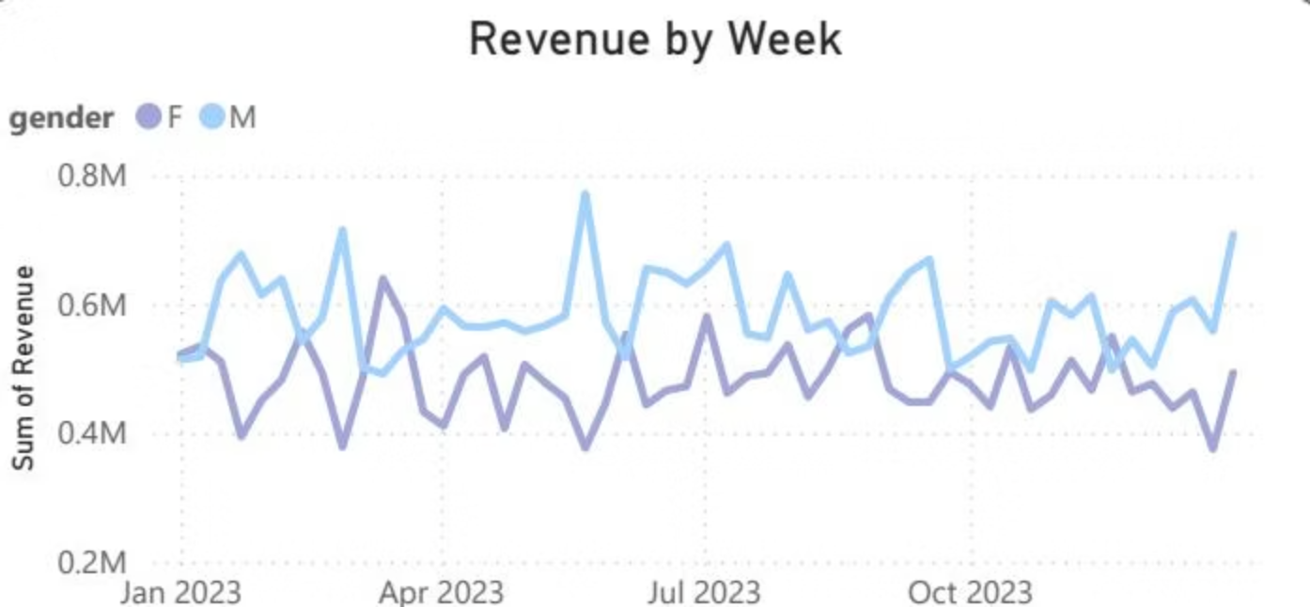
Customer Demographics Overview
Total Revenue
Total Income
Customer Score
$57M generated
$587.6M customer income
3.19 CSS rating
Gender Distribution
Male: $31M revenue
Female: $26M revenue

Slide 9
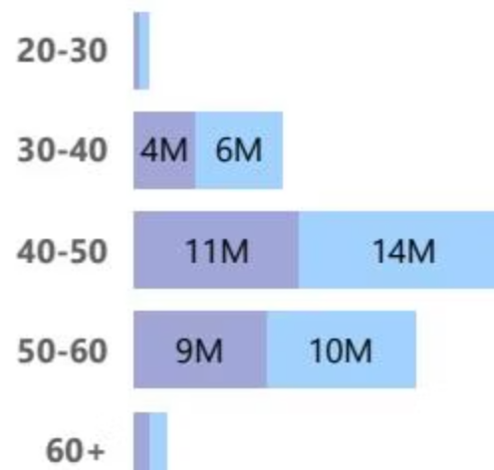
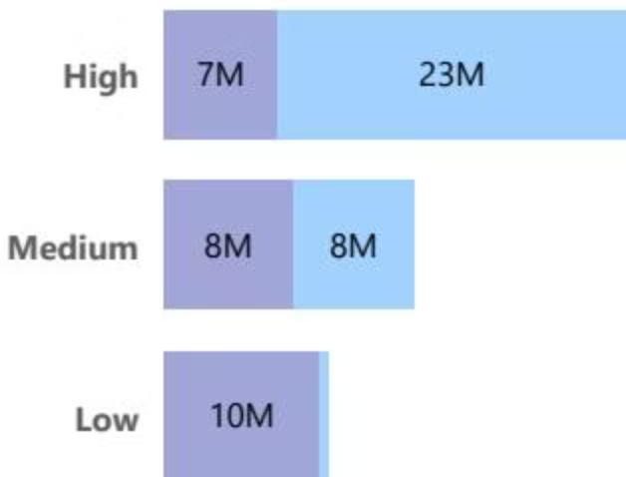
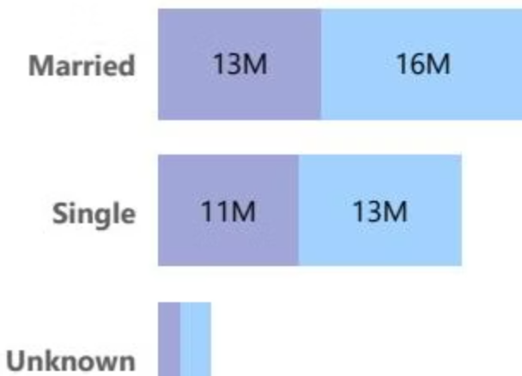
Revenue by Customer Segments
Age Groups
Income Groups
Marital Status
50-60: $14M
High: $23M
Married: $29M
40-50: $11M
Medium: $16M
Single: $24M
30-40: $10M
Low: $10M
60+: $9M

Slide 10
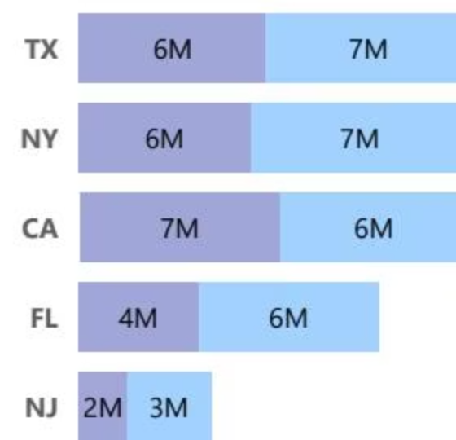
Geographic Revenue Distribution
23%
23%
23%
Texas
New York
California
$13M total revenue
$13M total revenue
$13M total revenue
18%
9%
Florida
New Jersey
$10M total revenue
$5M total revenue
Top five states contribute $54M combined, representing the majority of total revenue.

